Slide 1

GOOD MORNING

Slide 2
CORONAVIRUS DISEASE (COVID-19): Characteristics in children and considerations for Dentists providing their care
Mallineni SK, Innes NP, Raggio DP, Araujo MP, Robertson MD, Jayaraman J. International Journal of Paediatric Dentistry. 2020 May;30(3):245-50.

Slide 3
CONTENTS
INTRODUCTION
COVID-19 –
a. Clinical characteristics of COVID-19 in children
b. The child patient in the dental setting
c. Country-specific approaches & recommendations
d. The role of guidelines and professional judgment
CONCLUSIONS
RELATED ARTICLES

Slide 4
INTRODUCTION
Severe Acute Respiratory Syndrome Coronavirus 2
(SARS-CoV-2)
Global pandemic
Public Health Emergency of International Concern (PHEIC) by the World Health Organization (WHO) Director-General on the recommendation of the International Health Regulations (2005) Emergency Committee.
The first case of a dentist being tested positive for COVID-19 was reported on 23 January 2020 at the Department of Preventive Dentistry in the Wuhan University Dental Hospital.
Notes:
At the beginning of 2020, the novel virus severe acute respiratory syndrome coronavirus 2 (SARS-CoV-2) appeared, causing the coronavirus disease (COVID-19).
The emerging virus has resulted in a global pandemic declared a Public Health Emergency of International Concern (PHEIC) by the World Health Organization (WHO) Director-General on the recommendation of the International Health Regulations (2005) Emergency Committee.
Eventually, the transmission of disease to eight other oral healthcare professionals was identified.

Slide 5
Current data on the paediatric population affected with COVID-19 and emphasizes the importance of following locally, regionally, and nationally relevant safety measures to protect dental care professionals as well as the child patient, whilst providing clinical care for the obviously affected children and those potential carriers of the infection.
Practitioners must actively, regularly seek and use reputable and reliable sources of information on managing child patients that are appropriate for their own region and circumstances
Notes:
The characteristics of epidemiological spread and clinical manifestations of COVID-19 in children have not yet been thoroughly elucidated.
This article reports current data on the paediatric population affected with COVID-19 and emphasises the importance of following locally, regionally, and nationally relevant safety measures to protect dental care professionals as well as the child patient, whilst providing clinical care for the obviously affected children and those potential carriers of the infection.
We emphasise that, in a rapidly changing pandemic landscape, practitioners must actively, regularly seek and use reputable and reliable sources of information on managing child patients that are appropriate for their own region and circumstances

Slide 6
Clinical characteristics of COVID-19 in children
Similar but milder symptoms to adults
Dry cough which is usually accompanied by fever
Difficulty in breathing
Fatigue
Other less typical symptoms can also occur
Underlined by Mallineni et al. the WHO
Asymptomatic
Mild
Moderate
Severe
Critical
3092 Paediatric cases tested POSITIVE
Notes:
The clinical symptoms of COVID-19 are still being documented and collated, although the majority of affected patients exhibit symptoms including a dry cough which is usually accompanied by fever

Slide 7
Survey of 1391 children
China
171 (12.3%) cases - positive - SARS-CoV-2.8
Analysis of more than 2000 child patients
90% presented as asymptomatic or with mild to moderate symptoms.
Overall fatality rate of 1.36%-15% has been reported across all patients with COVID-19.
As of 31 March 2020, 7 fatalities have been reported in paediatric population due to COVID-19.
Chicago, New York, Belgium, England, China, France, Los Angeles.
Notes:
A survey of 1391 children in China found 171 (12.3%) cases tested positive for SARS-CoV-2.8
An analysis of more than 2000 child patients with suspected or confirmed COVID-19 in Hubei, China, found that over 90% presented as asymptomatic or with mild to moderate symptoms.

Slide 8
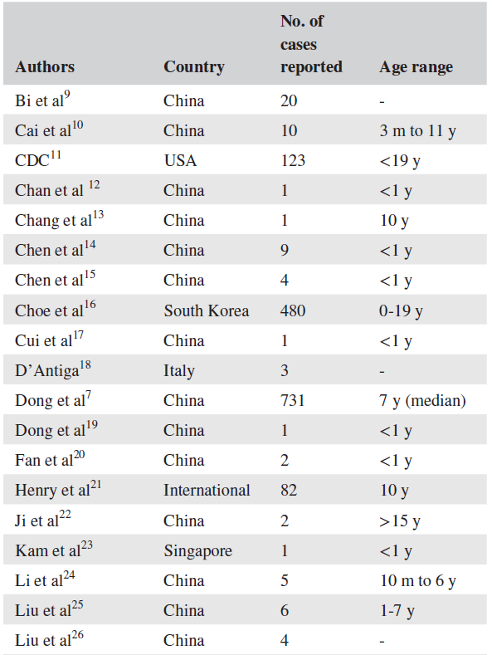
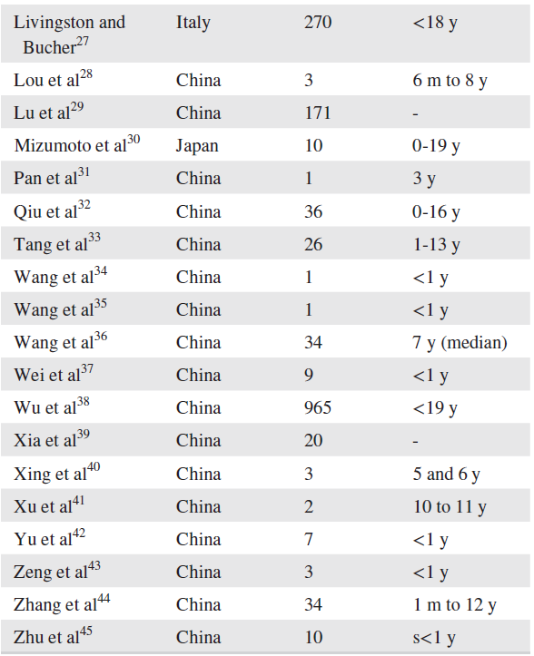
Summary of Paediatric cases reported with COVID-19
Notes:
These numbers are likely to be under-representative, as there is not universal testing of the whole population for the presence of COVID-19

Slide 9
The child patient in the dental setting
Transmitted through direct and indirect contact
Respiratory droplets and splatter from saliva and blood through contact with mucous membranes and contaminated fomites
Dental professionals in potentially high-risk situations
Aerosol Generating Procedures (AGPs), which have been associated with the transmission of acute respiratory infections
Dental chairs
Their handles
Spittoon
Dental instruments after treatment
Can persist on surfaces for up to 72 hours
Notes:
Because of the long incubation period (2-14 days)6 for everyone, and because children can be asymptomatic or present with mild, nonspecific symptoms, all child patients and parents should be considered as potential carriers of SARSCoV-2 unless proved otherwise.
and all clinic surfaces should be disinfected using chemicals recommended for eliminating SARS-CoV-2.

Slide 10
Universal precautions should be routinely followed in dental clinics.
They are critical for avoiding the transmission of SARS-CoV-2 virus to children as well as transmission from infected children to healthcare professionals.
Infection Prevention Checklist
Administrative measures
Infection prevention education and training
Dental healthcare personnel safety, programme evaluation
Hand hygiene, personal protective equipment (PPE)
Respiratory hygiene/cough etiquette
Sharps safety
Safe injection practices
Sterilization and disinfection of patient-care items and devices
Environmental infection prevention and control
Dental unit water quality.
Notes:
An infection prevention checklist should be used, including administrative measures, infection prevention education and training, dental healthcare personnel safety, programme evaluation, hand hygiene, personal protective equipment (PPE), respiratory hygiene/cough etiquette, sharps safety, safe injection practices, sterilization and disinfection of patient-care items and devices, environmental infection prevention and control, and dental unit water quality.

Slide 11
Country-specific approaches & recommendations
WHO - PANDEMIC - 6 different Phases
‘Widespread Human Infection’ phases
Dental practices remain open but there are screening activities and additional cross-infection measures
2. Closed all dental practices
3. Only emergency procedures
Notes:
Countries will be in different phases at different times; therefore, it is not possible to give universal guidelines so following local updated guidelines are essential.
All the above applies to child patients during the acute phase of COVID-19 pandemic, and the treatment choices and planning may vary during the next phases
Countries have put different measures in place for the overall delivery of dental care even during the ‘Widespread Human Infection’ phases of the pandemic leading up to the peaks of infection

Slide 12
Dental practices remain open but there are screening activities and additional cross-infection measures
Contain the disease spread quite quickly as seen in Singapore, for example where isolation and testing were put in place within a very short space of the infection being suspected as being present in the country.
Closed all dental practices
Such as the UK, have all cases triaged by telephone and attending only for very basic treatment in designated centres
Only emergency
And urgent dental care should be performed (from 20 march 2020), and all private offices have to stop elective treatments.
In Brazil, The National Health Surveillance Agency (ANVISA)
Notes:
The clinical symptoms of COVID-19 are still being documented and collated, although the majority of affected patients exhibit symptoms including a dry cough which is usually accompanied by fever

Slide 13
The role of guidelines and professional judgment
Local
Regional
National guidelines
Universal infection control procedures
Additionally, dental teams should be familiar with treatment options that minimize or eliminate AGPs—many of which are founded on contemporary cariology, well documented in the scientific literature, and minimally invasive by their nature.
Atraumatic Restorative Treatment (ART)
Sealing in carious
Lesions using fissure sealants
Silver Diamine Fluoride
Selective caries removal
Hall Technique.
Importance of tooth brushing with fluoridated toothpaste
Notes:
Guidance cannot ever cover all possible circumstances, and professional judgement must be exercised to make decisions around whether or not to provide treatment
Treatment should only be provided adhering to local, regional, and national guidelines as far as possible and, in the opinion of the dental professional, when it is safe for child patients, their accompanying carer, and for the dental team.
Healthcare guidance is being updated with alarming frequency, and confusion as to how best to proceed in a care setting is both evident and widespread.
importance of toothbrushing with fluoridated toothpaste to prevent tooth decay developing should continue to be emphasized

Slide 14
CONCLUSIONS
Reported clinical manifestations in children - generally less severe than those of adult patients, young children, and particularly infants, remain vulnerable to infection and pose a significant transmission risk.
Universal Infection Control Procedures
Preventive Dental Behaviours
Minimally Invasive Procedures
Notes:
Although reported clinical manifestations of COVID-19 in children are generally less severe than those of adult patients, young children, and particularly infants, remain vulnerable to infection and pose a significant transmission risk.
Dental teams must ensure they remain current in their understanding of local, regional, and national guidance in a climate of uncertainty and frequent change to optimise safety for dental care providers and patients.
Dentists who treat children during this pandemic should enact universal infection control procedures to the highest standard and champion this behavior through their teams.
Opportunities to promote preventive dental behaviours should be taken.
Contemporary, minimally invasive procedures that minimise or eliminate
aerosol generation should be employed where intervention is indicated throughout the pandemic, and in future as and when practice restrictions ease.

Slide 15
RELATED ARTICLE -1
COVID-19 Disease in Children: What Dentists Should Know and Do to Prevent Viral Spread. The Italian Point of View
Ferrazzano GF, Ingenito A, Cantile T.
International Journal of Environmental Research and Public Health.
2020 Jan;17(10):3642.

Slide 16
2019 novel coronavirus (2019-nCoV)
11 Feb 2020, - International Committee on Taxonomy of Viruses - new coronavirus capable of infecting humans as SARS-CoV-2
World Health Organization declared disease caused by this virus as COVID-19

Slide 17
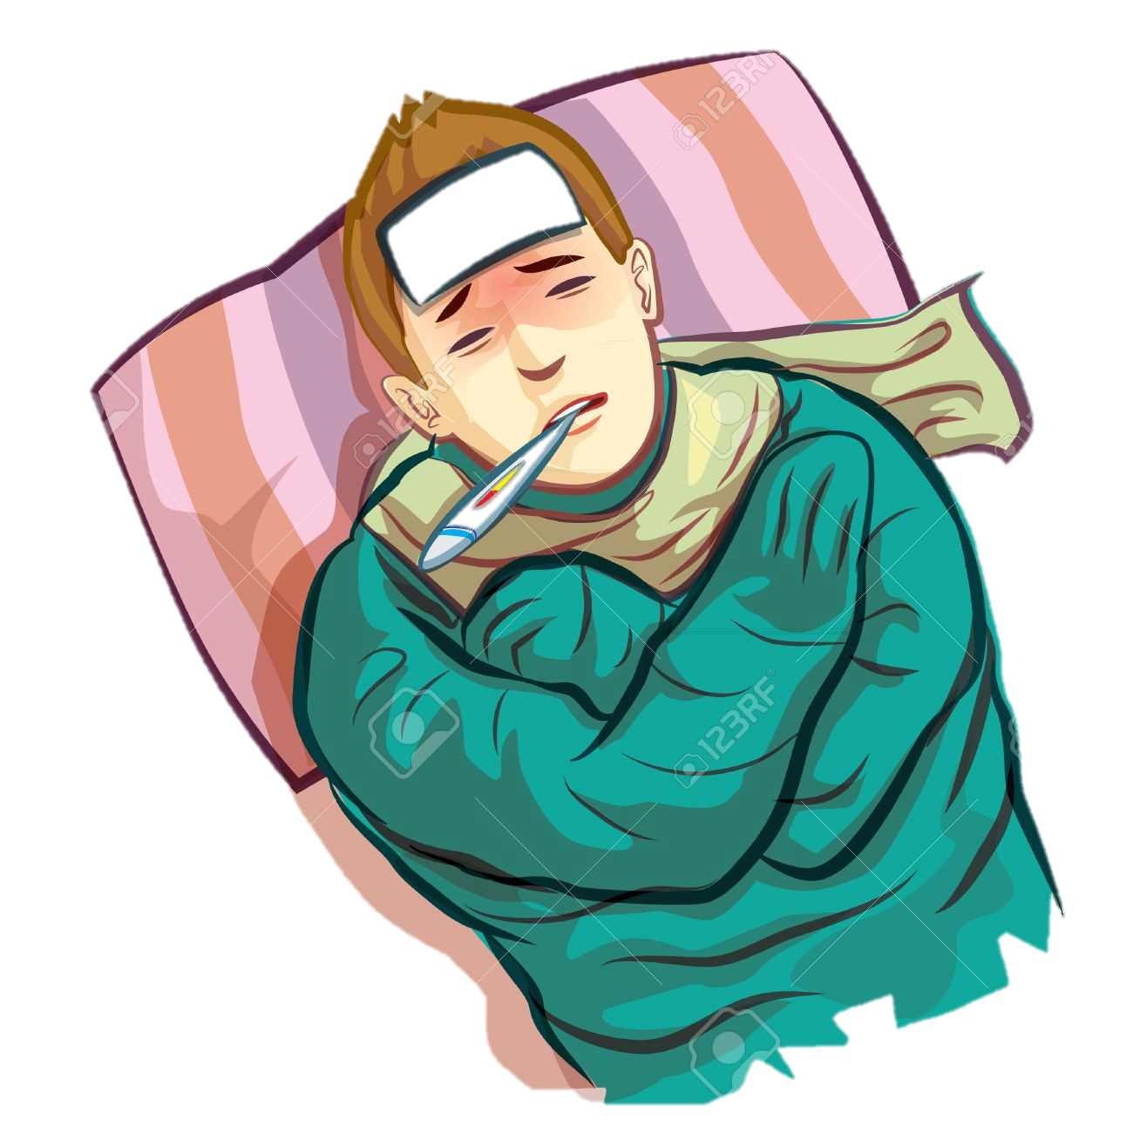

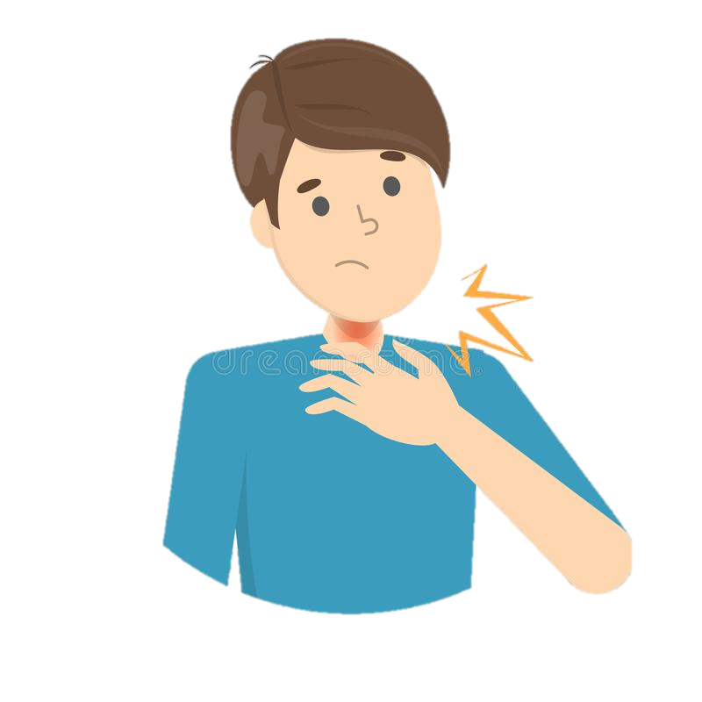
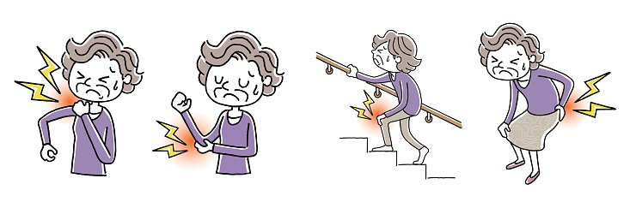
Severity - very mild to severe.
Complications - Pneumonia in both lungs
Organ failure in several organs & death
fever, Cough, shortness of breath or difficulty in breathing, tiredness, body aches, runny nose, sore throat.
Notes:
In adults,
signs and symptoms of COVID-19 may appear two to 14 days after exposure and can include: fever, ough, shortness of breath or diculty breathing, tiredness, body aches, runny nose, sore throat.

Slide 18
Lu et al.
Nasopharyngeal or throat swabs - 1391 children assessed
41.5%
fever
Cough & erythema
15.8%
No symptoms
12 patients
+ve Pneumonia radiographs
No symptoms
171 (12.3%) were confirmed
Dong et al
94 (4.4%)
Asymptomatic
1091 (50.9%)
Mild cases
831 (38.8%)
Moderate cases
2143 pediatric patients with COVID-19
Notes:
Fever was present in 41.5%
Cough & pharyngeal erythema
27 patients (15.8%) did not have any symptoms of infection or radiologic features of pneumonia.
12 patients had radiologic features of pneumonia
but did not have any symptoms of infection
A comprehensive study conducted by Dong et al. reported data on 2143 pediatric patients with COVID-19. Of them, 731 (34.1%) patients were identified as laboratory-confirmed cases and 1412 (65.9%) were suspected cases. For the severity of patients (including both confirmed and suspected cases), 94 (4.4%), 1091 (50.9%) and 831 (38.8%) patients were diagnosed as asymptomatic, mild or moderate cases, respectively, totally accounted for 94.1% of all cases [16].

Slide 19
The reason why COVID-19 cases in children are less severe than in adults is still confusing
Children having a more active innate immune response, healthier respiratory tracts because they have not been exposed to as much cigarette smoke and air pollution as adults, and less underlying illnesses
Weaker ability to trigger an acute inflammatory response to SARS-CoV-2 might also contribute to the children’s better outcome

Slide 20
Transmission Routes
Inhalation
Direct contact with blood, conjunctival, nasal or oral mucosa with droplets
Sabino-Silva et al. there is a minimum of 3 different pathways for COVID-19 to be present in SALIVA:
From COVID-19 in the lower and upper respiratory tract, that enters the oral cavity together with the liquid droplets frequently exchanged by these organs
COVID-19 present in the blood can access the mouth via crevicular fluid
By major- and minor-salivary gland infection, with subsequent release of particles in saliva via salivary ducts
DENTISTS SEEM TO BE THOSE AT HIGHEST RISK
This risk is even more serious in pediatric dentistry, being the majority of COVID-19 infected patients asymptomatic or mild and moderate symptomatic
Notes:
Thus, healthcare workers, in daily physical contact with patients, face an elevated risk of exposure to COVID-19.
Among healthcare personnel, dentists seem to be those at highest risk.
It is necessary to ensure their safety, not only to protect patient health, but to safeguard their-self from the viral infection and to avoid viral transmission

Slide 21
Routine dental practice should be postponed
Severe dental emergencies must be treated (such as discomfort, pain, swelling, life endangering dentigerous infection, traumatic dental injuries, etc.)
Pediatric patient, dentist should be aware of which recommended management protocol can be adopted during the practice, in order to prevent viral transmission
Notes:
Given that during the outbreak routine dental practice should be postponed and only severe dental emergencies must be treated (such as discomfort, pain, swelling, life endangering dentigerous infection, traumatic dental injuries, etc.), in the case of a dental emergency, involving a pediatric patient, dentist should be aware of which recommended management protocol can be adopted during the practice, in order to prevent viral transmission

Slide 22
CONCLUSIONS
Limited information on the model that dentists for dentists to follow.
Change daily routine dental practice all over the world.
No evidence that personal protective equipment and dental office disinfection procedures, commonly used in dentistry until now, could be safe enough.
Dental practice could need to be rethought and reorganized in order to ensure higher safety standards for both dentists and patients.
Situation continues to evolve day by day, pediatric dentists should keep a high level of awareness to help patients, minimizing risk and preventing viral spread.
Notes:
In the scientific literature, there is still limited information on the model that dentists should follow for the management of emergency dental procedure on children during COVID-19 outbreak.
COVID-19 outbreak will probably change daily routine dental practice all over the world.
Furthermore, at the moment, there is no evidence that personal protective equipment and dental office disinfection procedures, commonly used in dentistry until now, could be safe enough.
Actually, dental practice could need to be rethought and reorganized in order to ensure higher safety standards for both dentists and patients.
Finally, since the COVID-19 situation continues to evolve day by day, pediatric dentists should keep a high level of awareness to help patients, minimizing risk and preventing viral spread.

Slide 23
RELATED ARTICLE -2
COVID-19 and Paediatric Dentistry after the lockdown
Paglia L. European journal of paediatric dentistry. 2020 Jun;21(2):89.

Slide 24
Large family of respiratory RNA viruses
The virus binds to the cellular receptor ACE2, which in children has a structural and functional immaturity thus offering lower affinity to the pathogen.
This could explain the lower incidence of infection from SARS-CoV-2 in this segment of the population
Notes:
Coronaviruses are a large family of respiratory RNA viruses that can cause severe infections of the airways, as we have seen in the past, difficult months.

Slide 25
Ozone therapy could be of great help in the control of the progression of the asymptomatic carious lesions, especially during the Phase II of reopening, when we should to minimize the use of rotating instruments producing aerosols.
New Concept Of “No Aerosol”
Notes:
When possible, it is recommended to employ minimally invasive procedures and ART (Atraumatic Restorative Treatment). The latter is a technique that can also be employed in very young and uncooperative patients with widespread carious lesions, in order to avoid more invasive and complex procedures.
The above introduces a new concept of “no aerosol” that will possibly guide our therapeutic choices not only in the immediate future but also in the long term, opening scenarios of prevention and cure that are more efficient, safe, and sustainable

Slide 26
No aerosol
Virtual visits
Aerosol
Notes:
We will have to rethink and review the schedule of daily activities, in terms of timing and mode of delivery of care, on the basis of an agenda which can be divided into “no aerosol” and “aerosol” procedures, and “virtual visits” (including management of true emergencies), creating a virtuous optimisation of care for the safety of operators and office staff, as discussed in an article published on this very EJPD issue. In the coming months we will perhaps deliver more “patient-oriented” than “tooth-oriented” treatments, and this is true not only for young patients!

Slide 27
RELATED ARTICLE -3
Assessment of paediatric dental guidelines and caries management alternatives in the post COVID‑19 period.
A critical review and clinical recommendations
Al-Halabi M, Salami A, Alnuaimi E, Kowash M, Hussein I. European Archives of Paediatric Dentistry. 2020 Jun 16:1-4.

Slide 28
INTRODUCTION
Benign evolution in children and the infection runs in three major
Pavone et al. 2020
Mild cold-like illness
Moderate respiratory syndrome
Severe acute interstitial pneumonia
Notes:
SARS-CoV-2 infection seems to have a more benign evolution in children and the infection runs in three major stages: a mild cold-like illness, a moderate respiratory syndrome and a severe acute interstitial pneumonia (Pavone et al. 2020)

Slide 29
Evidence-based pertinent literature search of different electronic databases was performed in addition to leading Global dental authorities, royal colleges, and programmes
METHODS
Minimizing aerosol generating procedures (AGP) - use of non-invasive and minimally invasive caries management techniques
Special attention was given to medically compromised children
RESULTS
Triaging and only treating Emergency and urgent cases.
Detailed Guidelines for the dental environment and equipment

Slide 30
CONCLUSION
Specific recommendations for dental management of paediatric patients during and in the post-COVID-19 era are suggested.
Minimization of AGP procedures, and case-based selection of biological, non-invasive or minimally invasive methods are recommended.

Slide 31
RELATED ARTICLE -4
Dental Sedation Precautions and Recommendations during the COVID-19 Pandemic
Souza RC, Costa OS, Costa LR.. Rev Bras Odontol. 2020;77
Notes:
Revista Brasileira de Odontologia
Brazilian Journal of Dentistry

Slide 32
Brazilian national health surveillance agency (“Agência Nacional de Vigilância Sanitária” – ANVISA) - indicated that elective anesthesia procedures must be temporarily avoided during the pandemic phase
Brazilian Society of Anesthesiology –
Sedation and general anesthesia procedures- performed through closed circuits
Patients infected or suspected of being contaminated by COVID-19 are treated with anesthesia machines that are used specifically for such patients

Slide 33
Use non-pharmacological techniques to control the patient’s anxiety, e.g., those associated or not with protective stabilization (children and people with disabilities), and use minimal intervention dentistry techniques, when indicated.
Perform, in severe cases, dental care under general anesthesia using resolutive techniques to solve the patient’s dental problem that avoid returns or additional treatments in the short term

Slide 34
Do not perform dental procedures under inhalation sedation with nitrous oxide/oxygen during the COVID-19 pandemic in order to mitigate aerosolization and virus spread and the potential risk of performing life support measures that involve handling of airways and the use of hospital resources
Do not perform dental procedures under pharmacological sedation due to the need to provide oxygen and the potential risk of needing life support measures that involve the manipulation of airways and use of hospital resources

Slide 35

THANK YOU

